Slide 1
16/082022
PBiS focus:
Achieve – complete tasks
Learn – participation
Title: Linear equations
Aims:
Be able to
Use the DPM/A to expand bracketed terms.
Solve two-step linear equations
Need whiteboards and calculators
Plan:
Daily review:
Expanding brackets.
Solving equations

Slide 2
Choral response
The term outside the brackets multiplies to EVERY term inside the brackets.
4(3 + x)

Slide 3
DPM/A
I do, you copy
3(3 + f)
2x(x + 8)
3(d – 5)

Slide 4
Whiteboards – expanding brackets
4(2 + x)
5(3x – 4)
9(2 – x )
3(2x + d + 3)

Slide 5
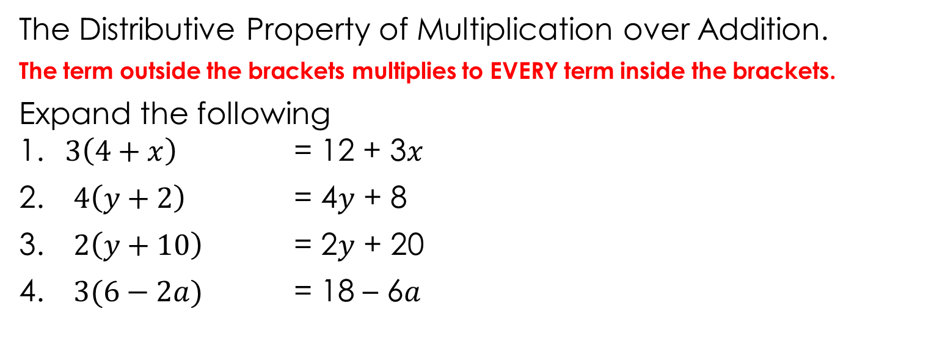
The Distributive Property of Multiplication over Addition.
The term outside the brackets multiplies to EVERY term inside the brackets.
Expand the following 1. $3\left(4+x\right)$ = 12 + 3$x$
$4\left(y+2\right)$ = 4$y$ + 8
$2\left(y+10\right)$ = 2$y$ + 20
$3(6−2a)$ = 18 – 6$a$
Notes:
Student worksheet

Slide 6
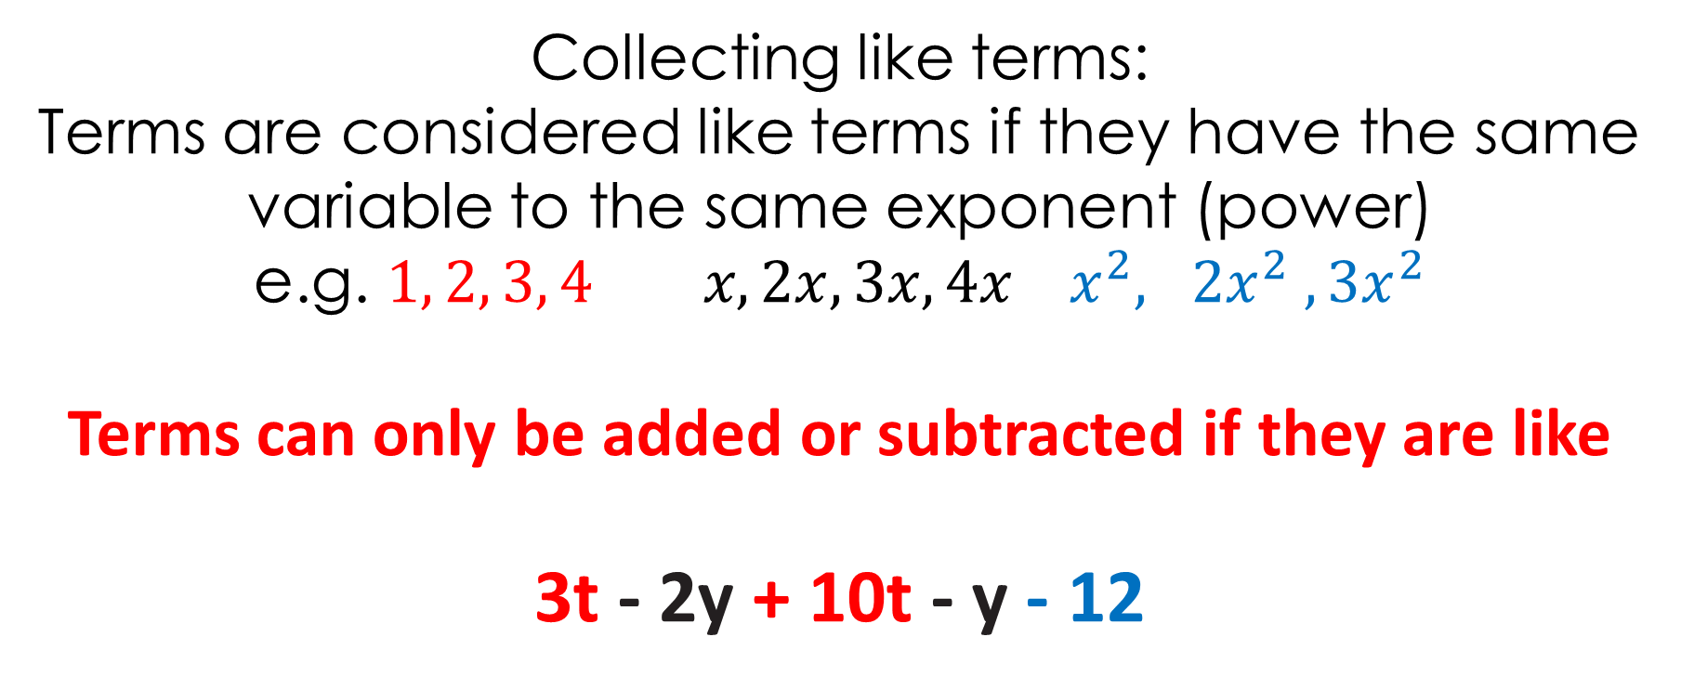
Collecting like terms:
Terms are considered like terms if they have the same variable to the same exponent (power)
e.g. $1, 2, 3, 4 x, 2x, 3x, 4x x^{2}, 2x^{2} ,{3x}^{2}$
Terms can only be added or subtracted if they are like
3t - 2y + 10t - y - 12

Slide 7
Collecting like terms:
We do
5y+3
2w+5
6s+3
You do
8x+4y
7m+9s
3a+6b+2

Slide 8
Steps to solve equations
Equation solving steps:
Simplify both sides
Collect variable terms to left and numbers to right – swap sides swap signs.
Simplify both sides
Divide both sides by coefficient.
State answer

Slide 9
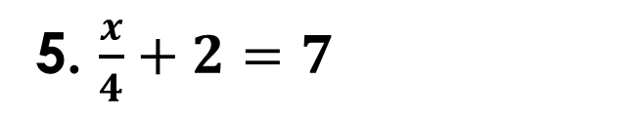
Try these equations; We do:
Simplify both sides
Collect variable terms to left and numbers to right – swap sides swap signs.
Simplify both sides
Divide both sides by coefficient.
State answer
5f + 4 = 24
2d – 8 = 12
4f + (-5) = 7
4x - 3 = 21
5. $\frac{x}{4}+2=7$

Slide 10
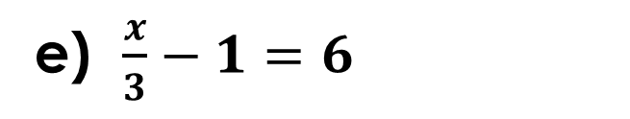
Whiteboards
3s + 8 = 23
10x - 20 = 30
10 – 3x = 4
9x – 6 = 21
e) $\frac{x}{3}−1=6$

Slide 11
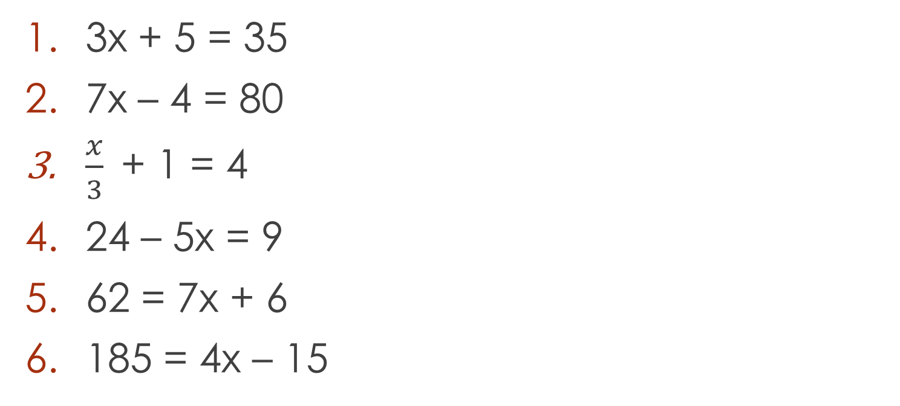
Try these equations;
Simplify both sides
Collect variable terms to left and numbers to right – swap sides swap signs.
Simplify both sides
Divide both sides by coefficient.
State answer
3x + 5 = 35
7x – 4 = 80
$\frac{x}{3}$+ 1 = 4
24 – 5x = 9
62 = 7x + 6
185 = 4x – 15

Slide 12
Answers
3x + 5 = 35
7x – 4 = 80
x/3 + 1 = 4
24 – 5x = 9
62 = 7x + 6
185 = 4x – 15
x = 10
x = 12
x = 9
x = 3
x = 8
x = 50

Slide 13
If the equation is more complicated;
Simplify the equation, collect like terms, if there are brackets multiply them out first.
If there is more then one unknown value on either side of the equals sign collect them together on one side and collect the numbers on the other.

Slide 14
2x + 4 = 3x - 2
Collect the x’s together, it is better to try and keep the x values positive.
Collect the numbers together on the other side of the equals.
4x + 2 = 10x – 16
2x + 8 = 10 + 3x

Slide 15
Try the following equations;
4x + 10 = 2x + 26
5x – 6 = 10x – 16
20x + 4 = 15x + 34
3(x + 1 ) = 15
2(3x + 2) + 3(x – 1) = 28

Slide 16
Answers
1) 4x + 10 = 2x + 26
2x +10 = 26
2x = 16
x=8
2) 5x – 6 = 10x – 16
- 6 = 5x -16
10 = 5x
2=x
3) 20x + 4 = 15x + 34
5x + 4 = 34
5x = 30
x = 6
4) 3(x + 1 ) = 15
3x + 3 = 15
3x = 12
x = 4
5) 2(3x + 2) + 3(x – 1) = 28
6x + 4 + 3x – 3 = 28
9x + 1 = 28
9x = 27
x = 3

Slide 17
Individual practice
On the back of our notes page is a puzzle sheet.

